Slide 1


Lecture 11
To insert your company logo on this slide
From the Insert Menu
Select “Picture”
Locate your logo file
Click OK
To resize the logo
Click anywhere inside the logo. The boxes that appear outside the logo are known as “resize handles.”
Use these to resize the object.
If you hold down the shift key before using the resize handles, you will maintain the proportions of the object you wish to resize.
Dr Richard Reilly
Dept. of Electronic & Electrical Engineering
Room 153,
Engineering Building

Slide 2
Counters
Why are they important ?
  Used in many many applications
    Microprocessors
    Computing
    Communications
    Electronic automation

Slide 3
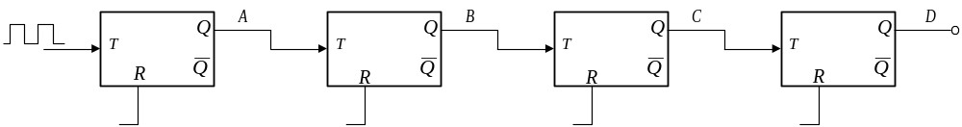
Ripple through Counters
Counting is a fundamental function of digital circuits
• a digital counter consists of a collection of flip-flops that change state (set or reset) in a prescribed sequence.
• Flip-flops are commonly used in the design of counters the most straightforward counter is a ripple counter.
Recall the Ripple Through Binary Counter Modulo-10 (Asynchronous)

Slide 4
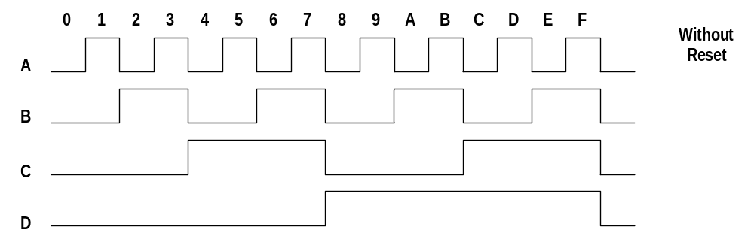
Design of Synchronous Counters
Operation
• At each negative edge of the input clock ⇒ flip-flop-A toggles,
• likewise at each negative edge of Q_A ⇒ flip-flop B toggles
The outputs go through the sequence and return to zero.

Slide 5
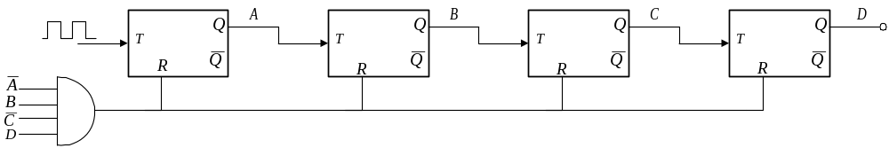
Design of Synchronous Counters
If we want a decade counter we can apply a reset when DCBA = 1010
and force outputs of A, B, C and D to be logic 0.

Slide 6
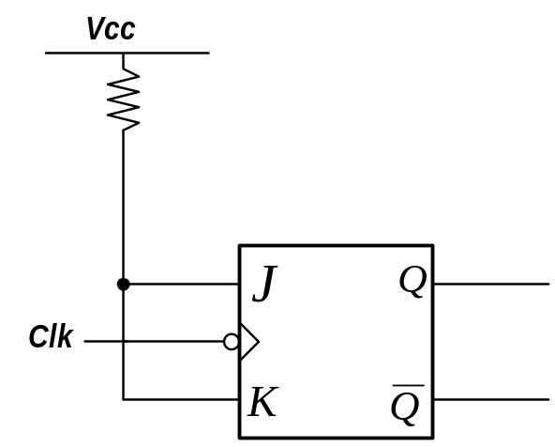
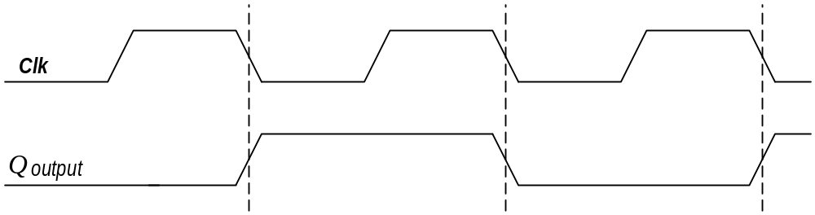
Divide-by-2, 4, 8 Counters (asynchronous)
Use a toggle flip-flop (J-K connected together)
• the output of the flip-flop “toggles” at every clock pulse
Divide-by-2 counter
NOTE : negative clock pulsed clock
The circuit divides the clock frequency by 2.

Slide 7
Divide-by-2, 4, 8 Counters (asynchronous)
Divide-by-2, 4, 8 counters can also be designed,
⇒ circuit divides the clock frequency by 2, 4 or 8
Divide-by-n Counters are asynchronous
No common synchronising clock input is applied to all the flip-flops.
Clock is actually used for data in these applications.

Slide 8
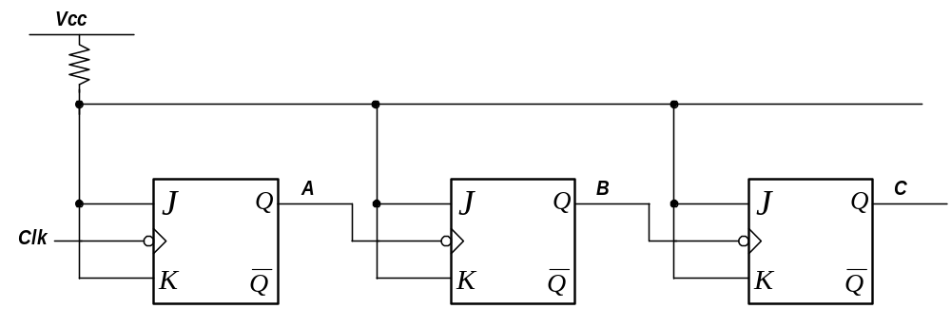
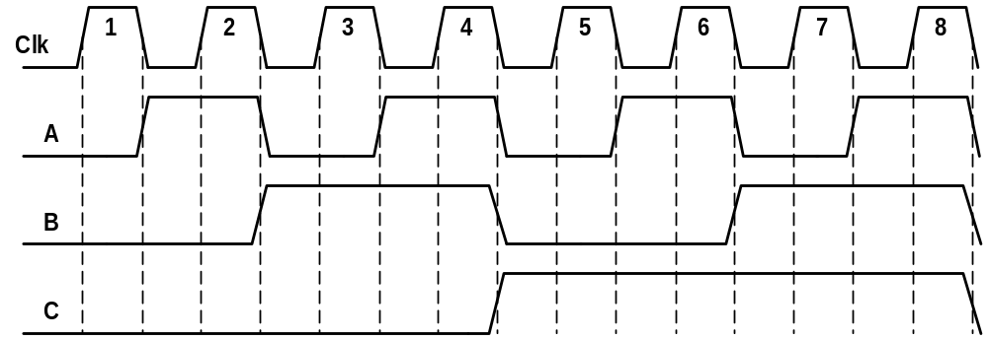
Divide-by-2,4,8 Counter (asynchronous)
Synchronous Counters are distinguished from ripple counters in that clock pulses are applied to the clock inputs of all the flip-flops.
common pulse triggers all flip-flops simultaneously rather than one at a time in succession (as in ripple counter)

Slide 9
Synchronous Binary Counter
In a binary counter the flip-flop in the lowest -order position is complemented on every clock pulse.
Consider a Modulo-5 Counter
0
0
0
0
0
1
0
1
0
0
1
1
1
0
0
A
B
C

Slide 10
Synchronous Binary Counter
If we wish to implement a design made up of J-K-flop-flops
How Many flip Flops ?
  Have three bits A, B and C.
  3 J-K’s are required, one for each bit,
Why do we need the flip flops ?
• Need the flip-flops to change their outputs so that the counter counts in the correct sequence.

Slide 11
Why do we need the flip-flops to do ?
• Wish clock pulse to change output of flip-flop C every pulse
• Wish clock pulse to change output of flip-flop B every 2nd pulse
• Wish clock pulse to change output of flip-flop A every 4th pulse
0
0
0
0
0
1
0
1
0
0
1
1
1
0
0
A
B
C

Slide 12
Synchronous Binary Counter
Use the excitation table of the J-K flip-flop to observe the required inputs at J and K to achieve this switching procedure.
Q_{t-1}
Q_{t}
J
K
0
0
0
X
0
1
1
X
1
0
X
1
1
1
X
0

Slide 13
Synchronous Binary Counter
An excitation table for the counter can be constructed
A
B
C
J_{A}
K_{A}
J_{B}
K_{B}
J_{C}
K_{C}
0
0
0
0
X
0
X
1
X
0
0
1
0
X
1
X
X
1
0
1
0
0
X
X
0
1
X
0
1
1
1
X
X
1
X
1
1
0
0
X
1
0
X
0
X

Slide 14
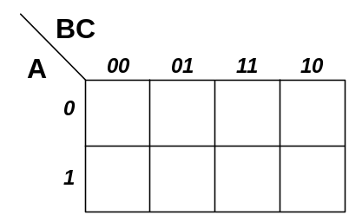
Synchronous Binary Counter
J_{C}
K_{C}

Slide 15
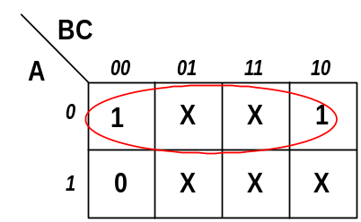
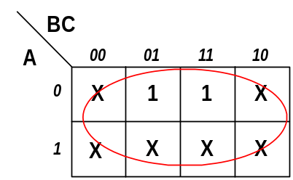


Synchronous Binary Counter
J_{C}
K_{C}

Slide 16
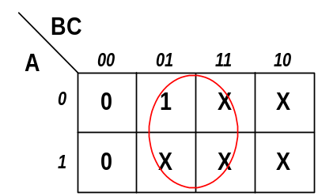
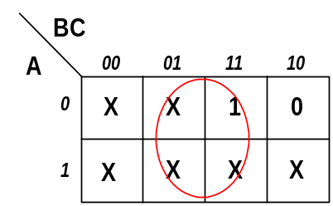


Synchronous Binary Counter
J_{B}
K_{B}

Slide 17
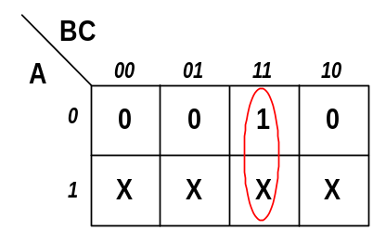
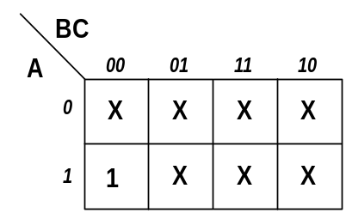


Synchronous Binary Counter
J_{A}
K_{A}

Slide 18
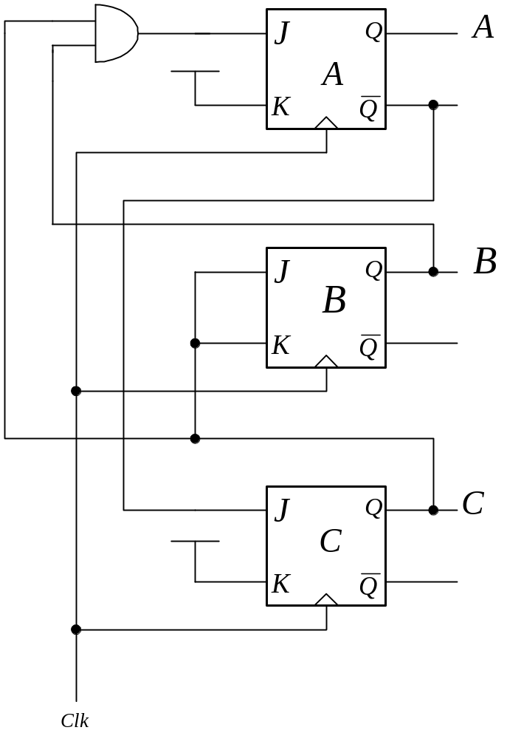
Synchronous Binary Counter
NOTE
Implementation for two of the K inputs requires that they be at logic level
To fulfil the requirement the inputs are connected to the Logic Level 1 reference (normally +5v).
Circuit arrangement can be easily designed to form a down counter.
:

Slide 19
Homework
Design a counter which counts in the following sequence.
        1 0 1
        1 0 0
        0 1 1
        0 1 0
        0 0 1
        0 0 0
Solution will be available on the website

Slide 20
Johnson Counter (synchronous)
As with other designs the output of one flip-flop is fed into the input of the next one.
Did we not do this before….what is different here ?
This time output of the last D flip-flop is fed into the input of the first flip-flop.
In general the complement of the Most Significant Output is connected to the Least Significant input.

Slide 21
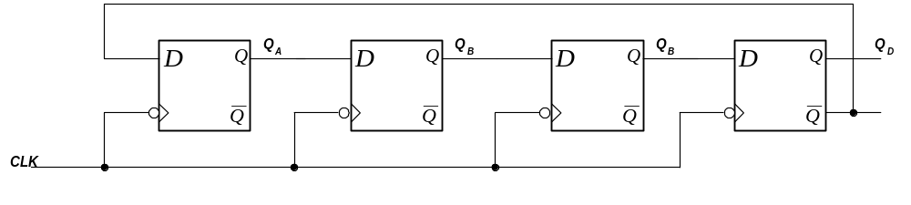
Johnson Counter
NOTE :
• This is a synchronous design as all the clocks are connected to a common synchronising clock.
• state changes for all affected flip-flops occur at the same time.
⇒ 1st negative edge will cause the flip-flop A to set.

Slide 22
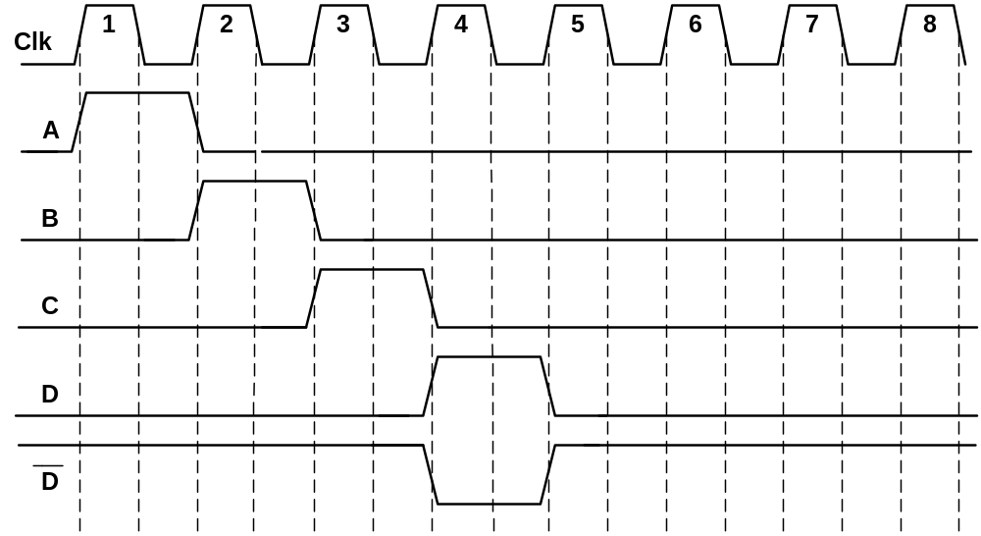
Johnson Counter
Process continues as long as power is applied and clock is present.
The main use of this counter design is the generation of time delays for control applications.

Slide 23
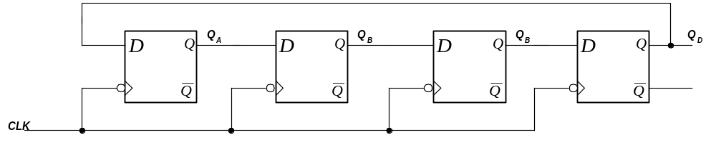
Ring Counter (Synchronous)
Another counter where the output of one flip-flop is connected directly to the input of another to produce a particular pattern.
In this case the data/bit is shifted from one flip-flop to the next on each negative edge of the clock pulse.
i.e. The 1-bit is shifted from one state to the next.

Slide 24
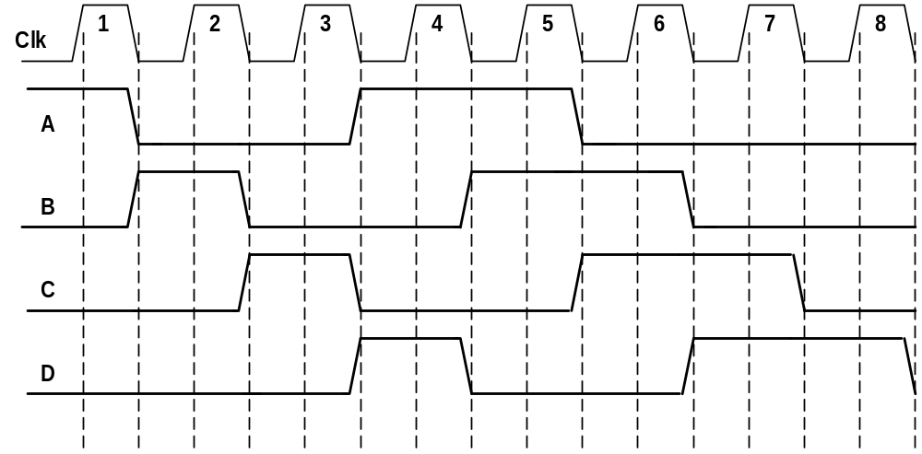
Ring Counter (Synchronous)
• Can be initialised to particular vale e.g. ABCD = 1000
Used to produce a repeating n-bit pattern

Slide 25
Counters
Why are they important ?
  Used in many many applications
    Microprocessors
    Computing
    Communications
    Electronic automation

Slide 26
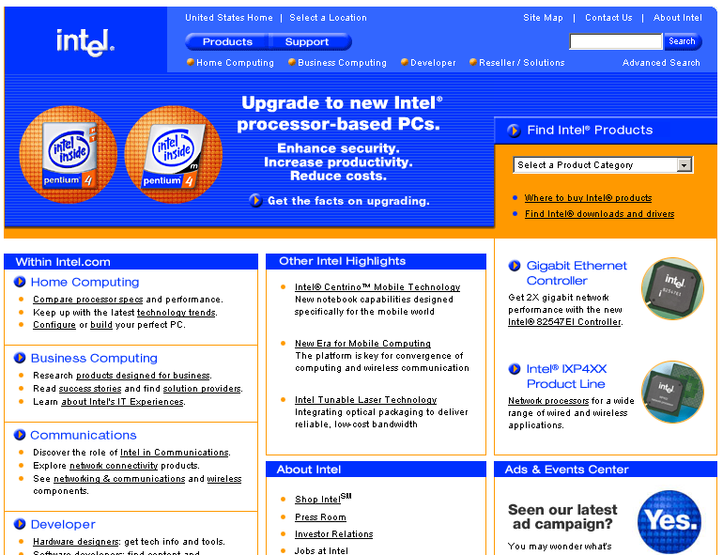

Slide 27
Applications for Counters
Microprocessor clock may be at 1GHz.
  Used to synchronise all events.
  But other circuits within the microprocessor at this fast speed
    Need to reduce the clock speed to these slower circuits.
    Use a Divide-by-N counter !

Slide 28
Communications
How fast can we send information to others ?
Depends on what medium we are using
  Wireline (copper wire, optic fibre)
  Wireless (GSM, GPRS, Bluetooth 802.11)
All have standards for transmission of information

Slide 29
Home Modem
What speed is typical for a home modem on a standard telephone line ?
56kbps is the maximum
  But 48kbps or even 33kbps more typical
  Need counters to reduce frequency to allow communication
What speed is typical for a home modem on a DSL line ?
1Mbps is typical

Slide 30
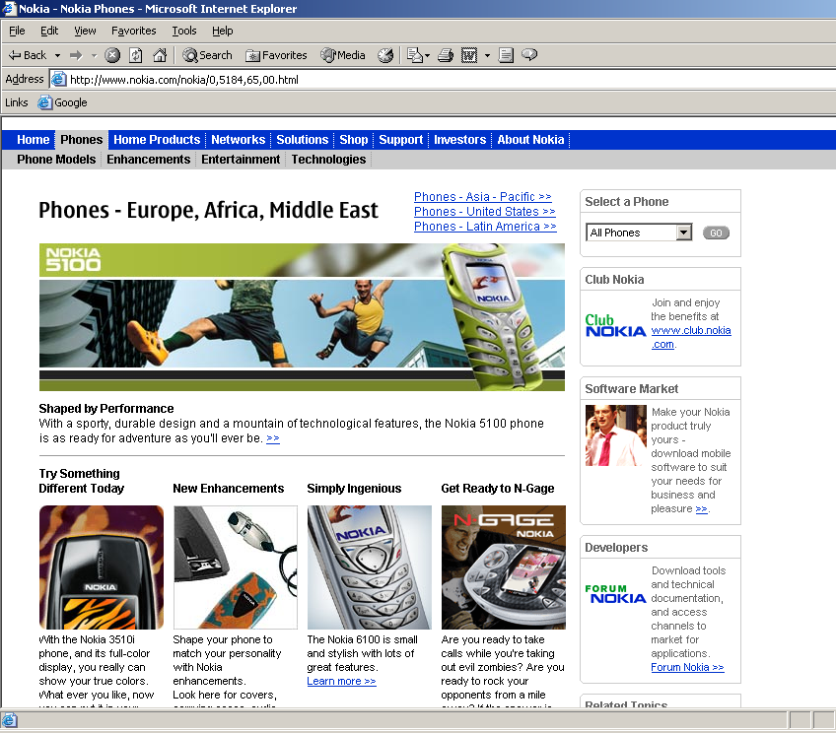

Slide 31


Slide 32
Summary
Counters are very important
  Used in many many application areas
  Can be simply constructed from flip-flops

